Slide 1
From spatial data to published interactive maps using R
Wanda Bodnar
21/01/2026

Slide 2
Schedule
10.00 – 11.00: Session 1 — Creating and loading spatial data
11.00 – 12.00: Session 2 — Publication-ready static maps in R
12.00 – 13.00: Lunch
13.00 – 14.00: Session 3 — Interactive maps and mixed data sources
14.00 – 15.00: Session 4 — Publishing maps online

Slide 3
Pre-session preparation
Install R and Rstudio
Source: posit.co/download/rstudio-desktop/
Download R and install R first then R Studio

Slide 4
Pre-session preparation
Install required R packages

Slide 5
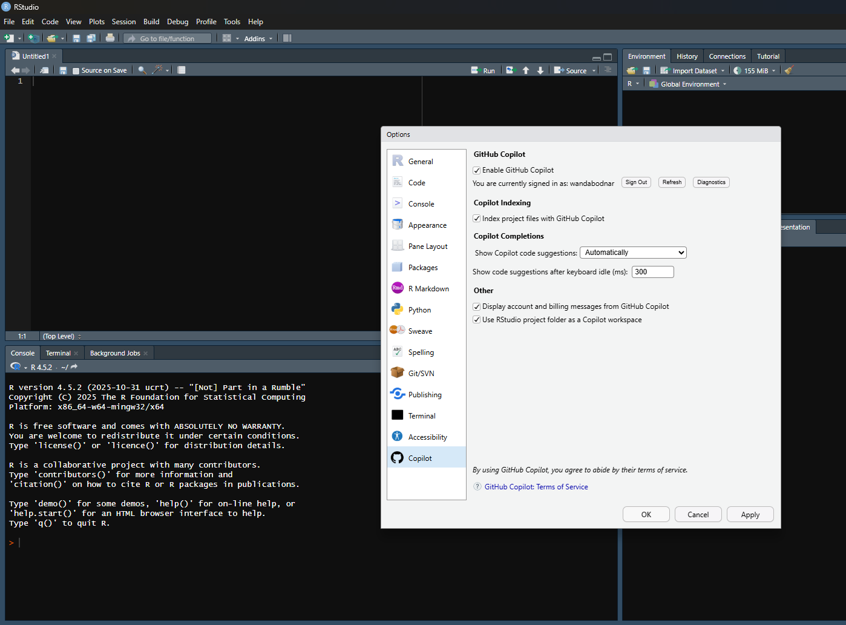
Pre-session preparation
Set up a GitHub account
Link with R Studio
Using Copilot
Tools -> Global options -> Copilot -> Enable Github Copilot
Install GitHub Desktop

Slide 6

Session info and files
github.com/wandabodnar/ioz

Slide 7
Session 1
21/01/2026

Slide 8
Creating and loading spatial data
Load tabular + spatial files
Understand geometry columns
Check / align CRS across layers
Combine layers in one map
Explore projection choices
Extra: convert to GeoJSON

Slide 9
Creating and loading spatial data
Create a dedicated folder called Data
Open geojson.io/
Create: 1 point (site), 1 line (transect), 1 polygon (area of interest)
Explore 3D format
Add 1–2 attributes (e.g. id, type)
Export: .geojson, .csv, .shp

Slide 10
Creating and loading spatial data
What is the .geojson format?
A GeoJSON file is a simple, text-based format for storing spatial data (geographic features and their attributes) in a way that works across many tools: GIS software, R, and web maps. It is written in JSON (JavaScript Object Notation) and designed for web mapping and data sharing.

Slide 11
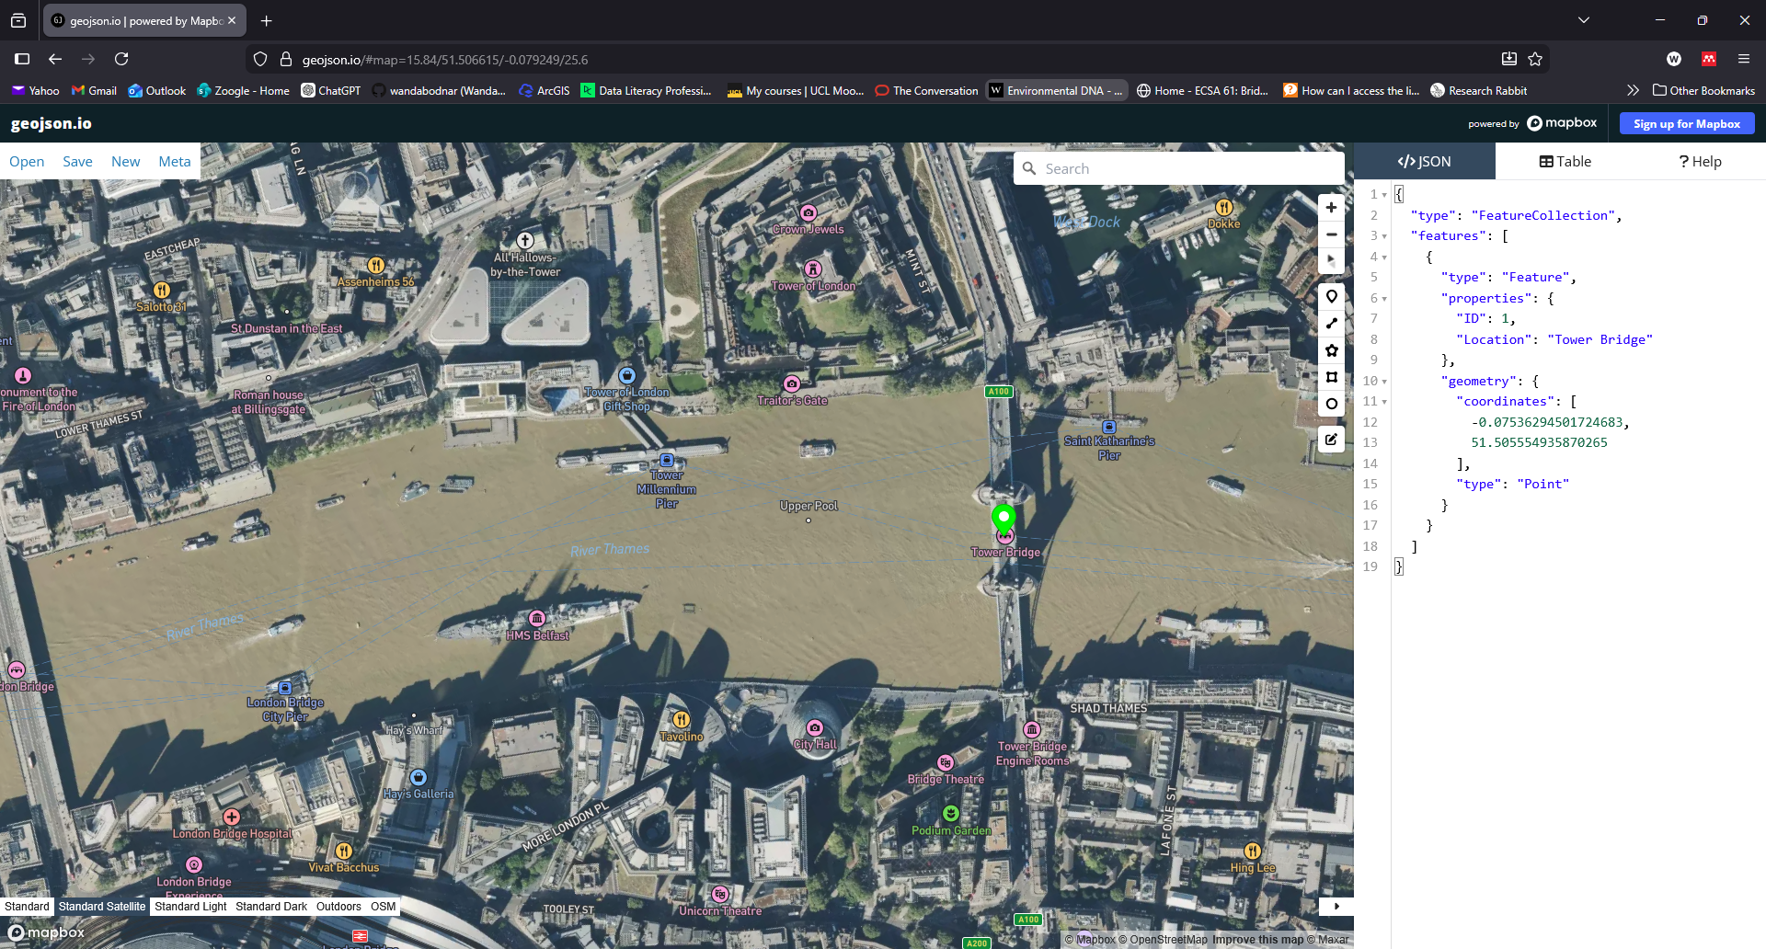
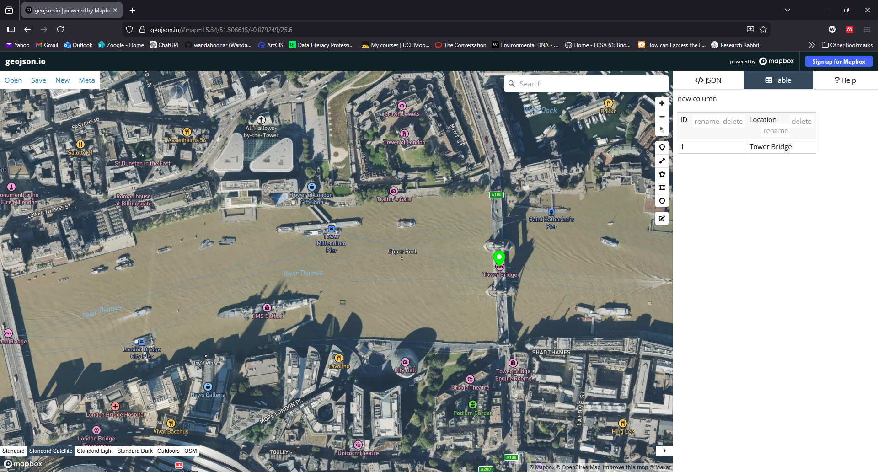
Creating and loading spatial data
What is the .geojson format?
Every GeoJSON file has three parts:
Geometry: shape: e.g. point, line or polygon
Properties: attribute table (IDs, names, categories)
Coordinate reference system: Usually WGS84 (longitude, latitude)

Slide 12
Creating and loading spatial data
Can you save the point, line and polygon data in a single .geojson file?
Yes, but most GIS software and analysis tools expect one geometry type per layer. Mixing points, lines, and polygons makes spatial operations ambiguous and error-prone, so best practice is to store each geometry type in a separate file or layer.

Slide 13
Creating and loading spatial data
What is the shapefile format?
A shapefile is a classic GIS vector data format, originally developed by ESRI, and still widely used in desktop GIS.
It stores:
geometry (points, lines, or polygons)
attributes (a table)
spatial reference information

Slide 14
Creating and loading spatial data
What is the shapefile format?
Despite the name, a shapefile is actually a set of files that must stay together.
The three core components are:
.shp: geometry (the shapes)
.shx: index (how shapes are stored)
.dbf: attribute table
Common additional files:
.prj: coordinate reference system
.cpg: text encoding
If you lose or rename one of these, the shapefile may break.
Best to covert it to .geojson when web mapping (e.g. in QGIS)

Slide 15
Creating and loading spatial data
File format | Data type | Strength | Weakness
Shapefile | Vector | Widely supported, fast for small datasets | Multi-file structure, 2GB limit
GeoJson | Vector | Single file, best for web-mapping | Not efficient for large / complex data
CSV | Tabular (point) | Simple, easy to share | Not GIS native by default

Slide 16
Creating and loading spatial data
In the Data folder:
one .csv
one .geojson
one shapefile folder with point, line and polygon data

Slide 17
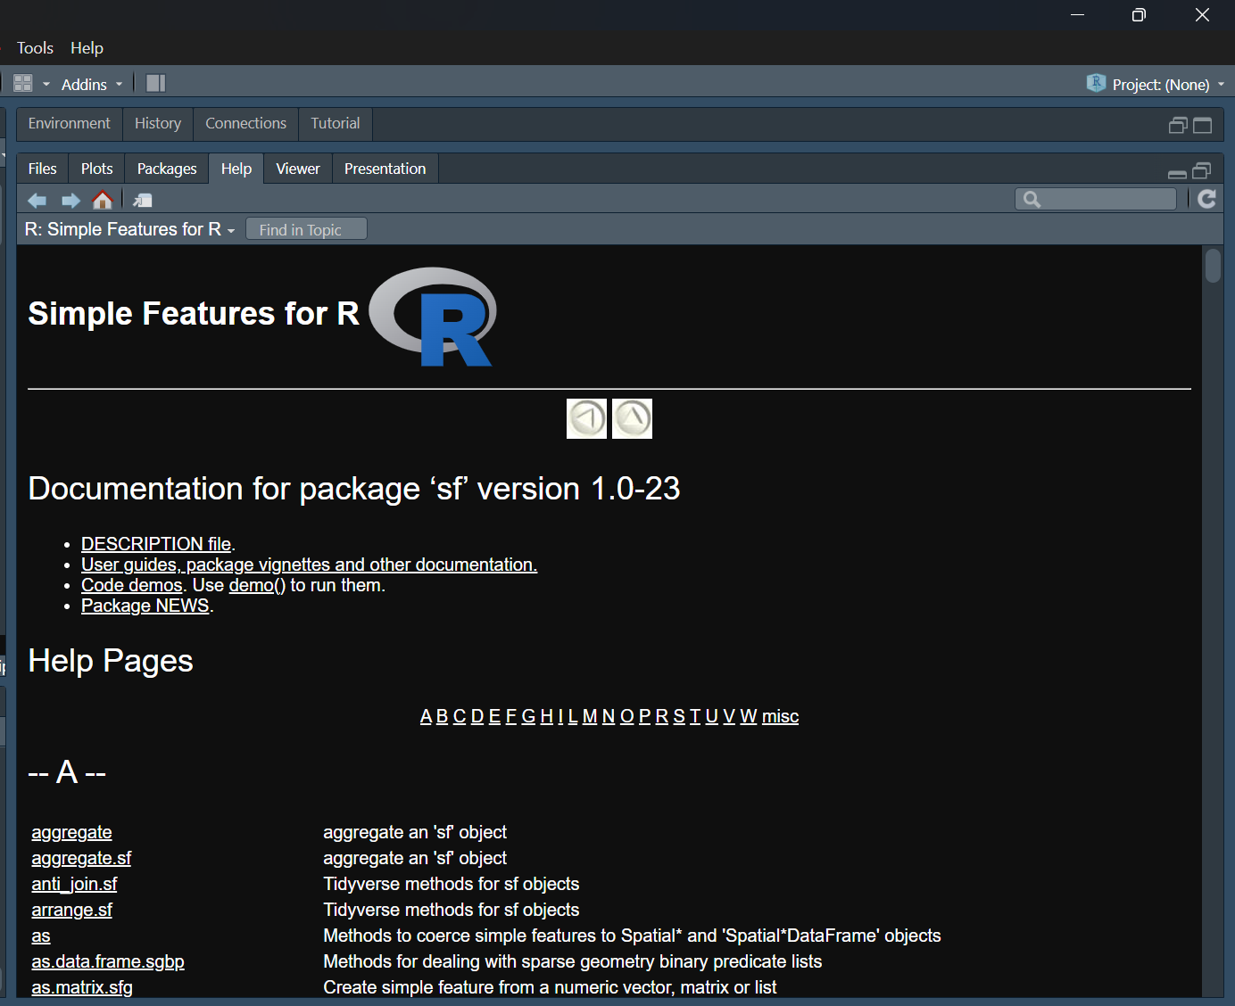
Creating and loading spatial data
R Studio environment
In R studio:
New R script
Set WD
Packages
Help

Slide 18
Creating and loading spatial data
.csv file
Load
Glimpse
Conversion to spatial data
.csv has no built-in understanding of geography
.geojson and .shp
Already contain geometry definitions and CRS information

Slide 19
Creating and loading spatial data
Coordinate Reference System
A coordinate reference system, or CRS, defines how to measure and represent locations on Earth (3D) as coordinates on a map (2D)
CRS tells the computer what the numbers mean
Without it, coordinates are just numbers
Earth is roughly spherical
Impossible to flatten it into a 2D map without distorting at least one of its geographic properties: area, shape, distance, or direction

Slide 20
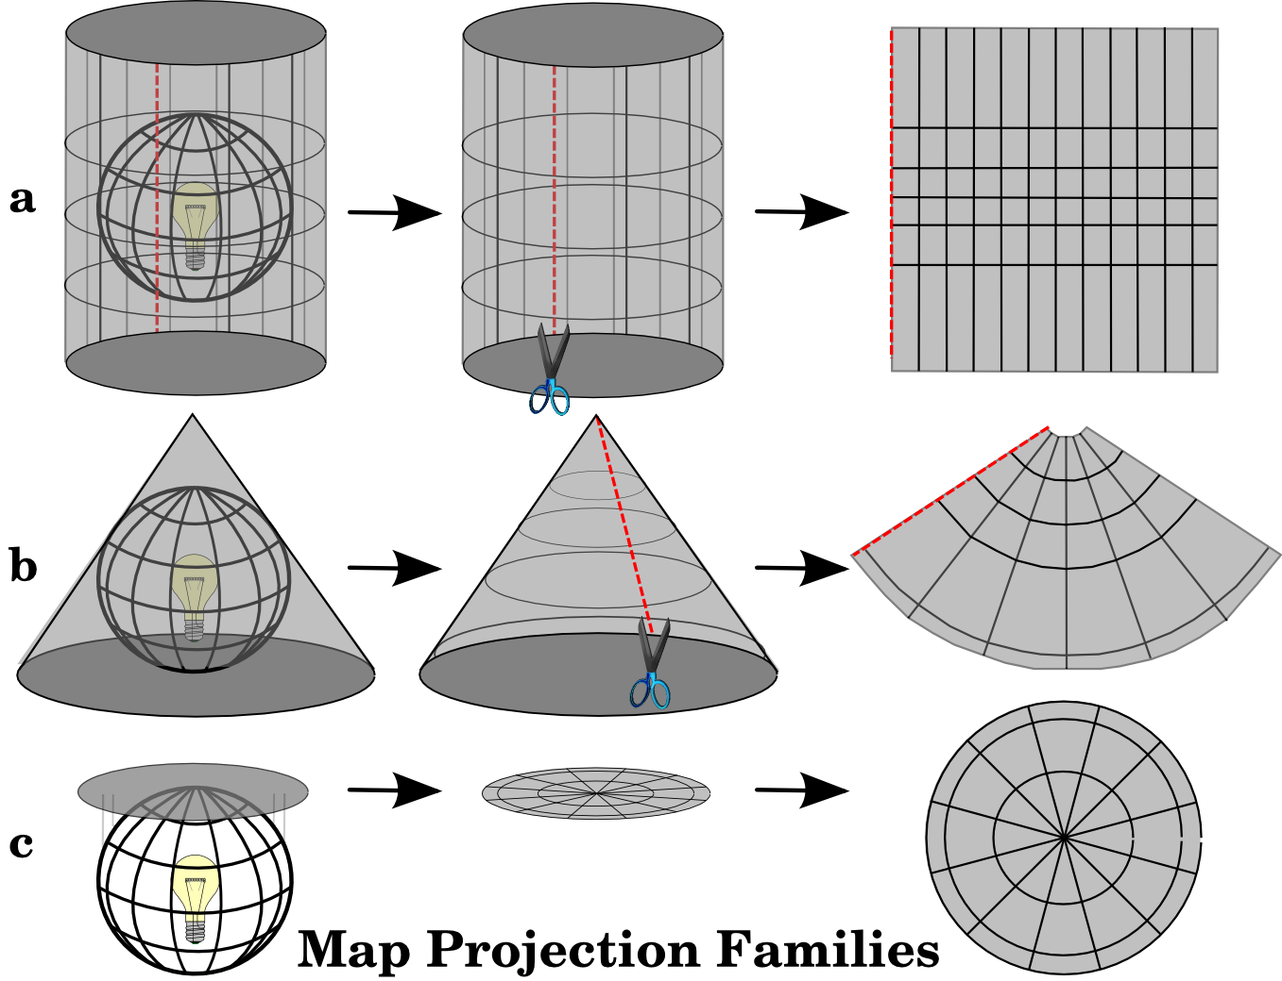
Creating and loading spatial data
Coordinate Reference System
Cylindrical: These are widely used for world maps and navigation
Conic: Best for mid-latitude regions
Planar: For polar regions or maps showing directions from a central point

Slide 21
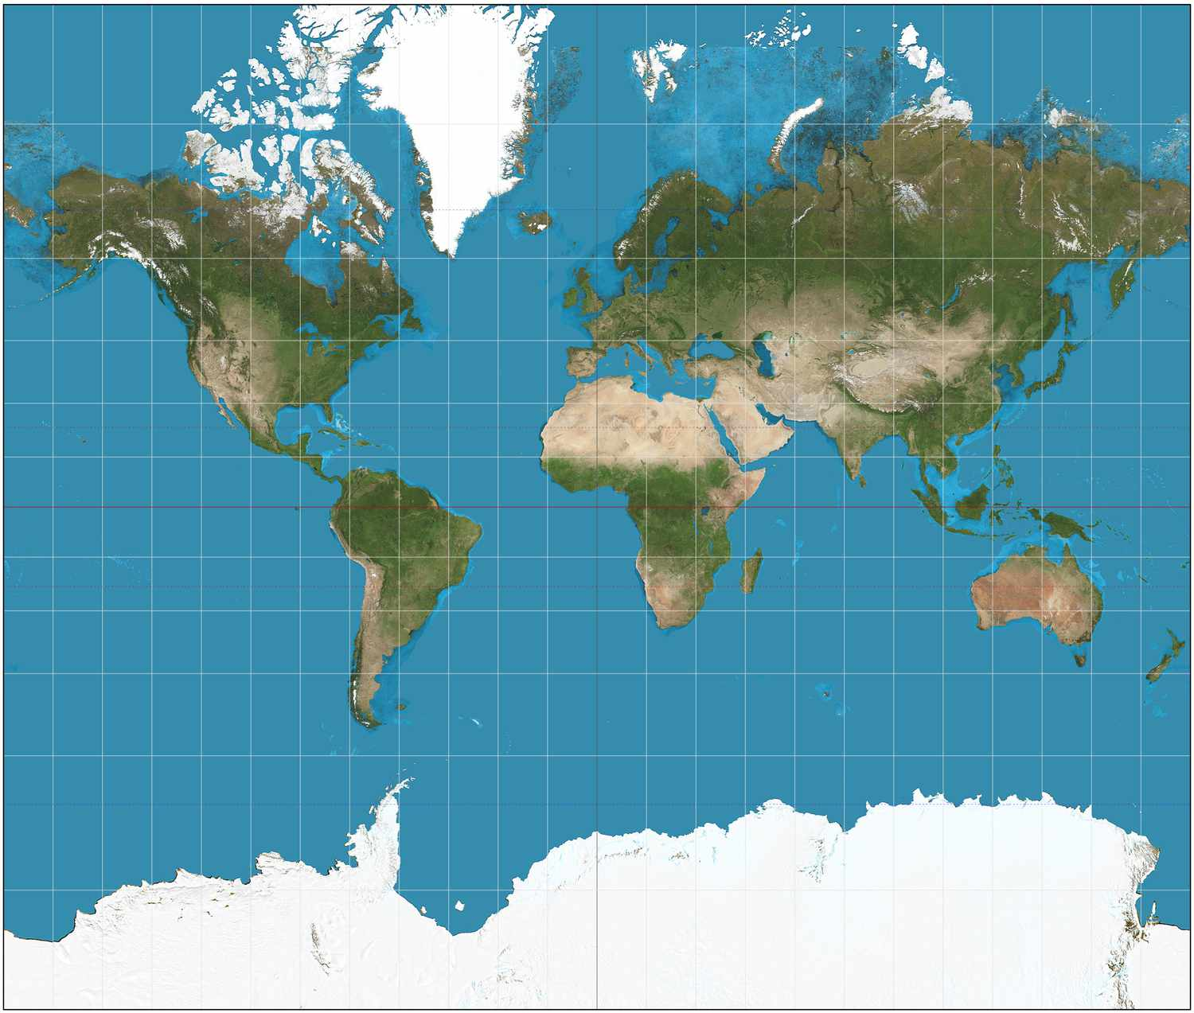
Creating and loading spatial data
Coordinate Reference System
No projection can preserve all geographic properties simultaneously
Conformal: Maintains local shapes and angles accurately

Slide 22
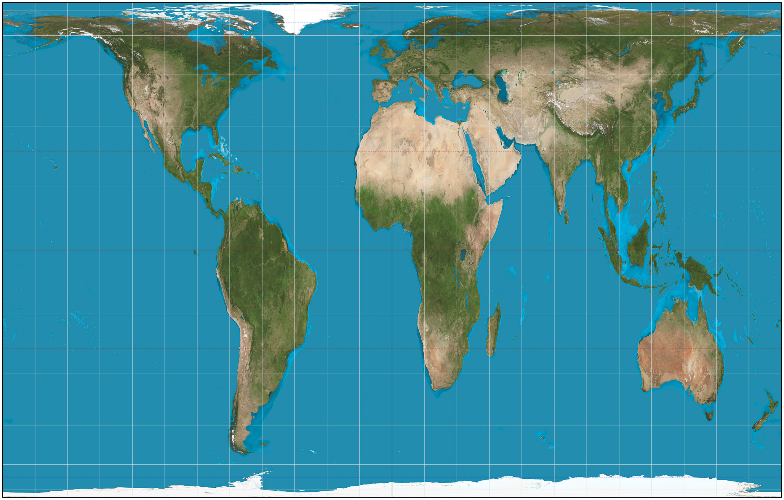
Creating and loading spatial data
Coordinate Reference System
No projection can preserve all geographic properties simultaneously
Equal-Area: Maintains the relative size of landmasses but distorts their shapes

Slide 23
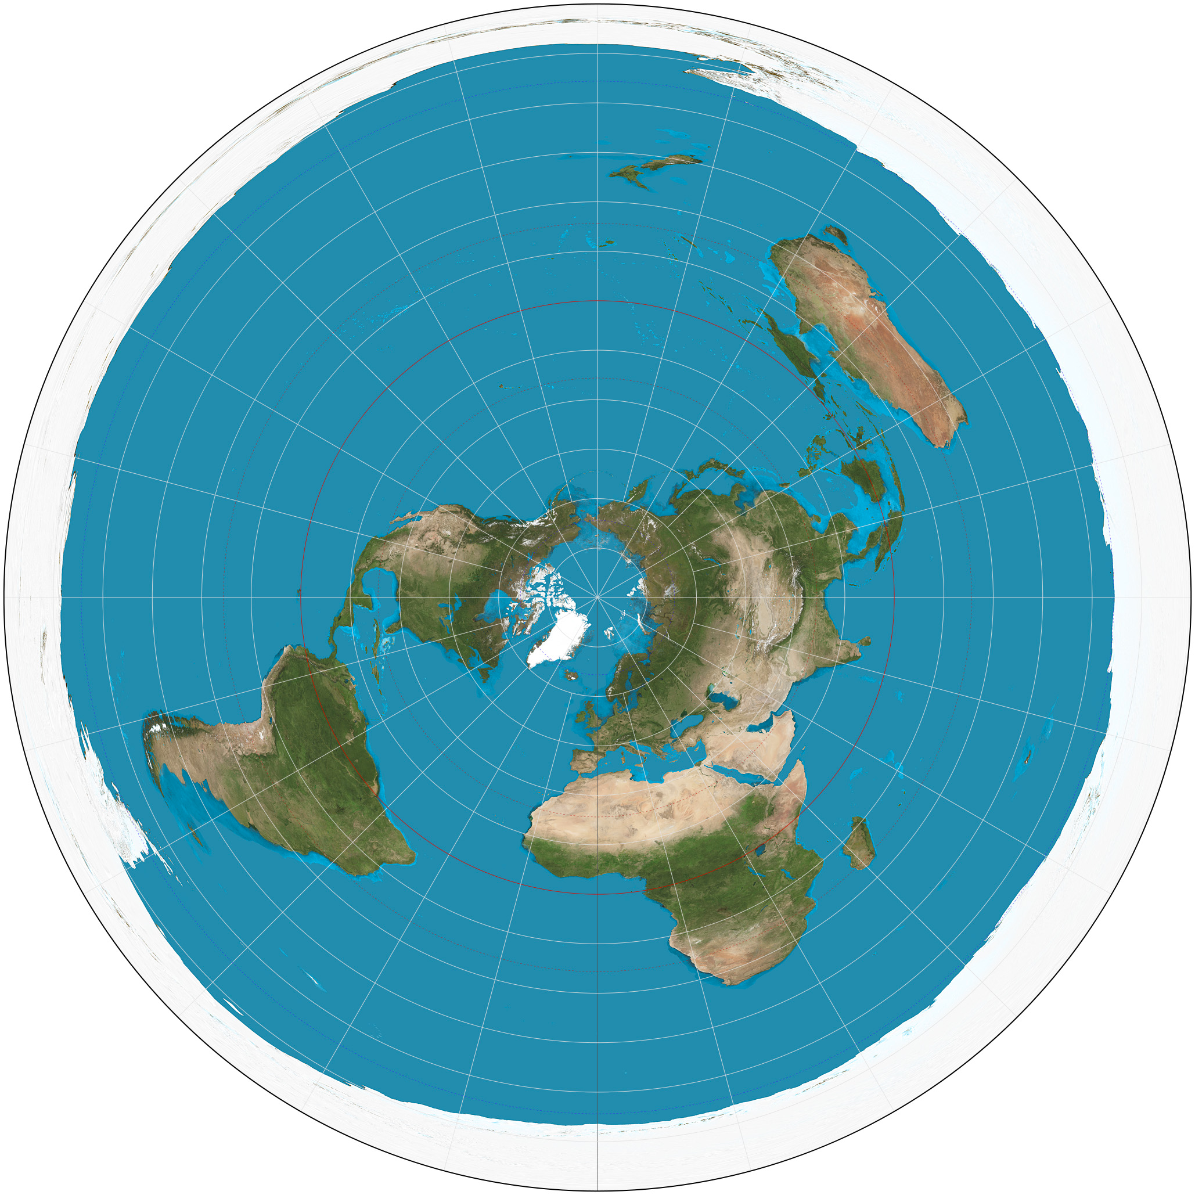
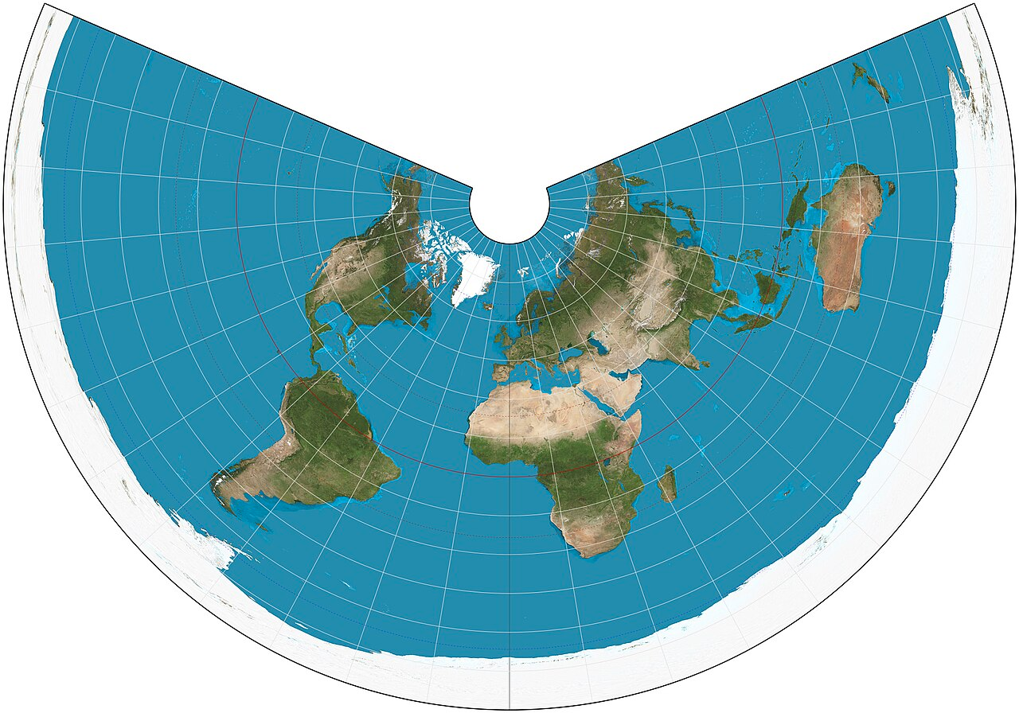
Creating and loading spatial data
Coordinate Reference System
No projection can preserve all geographic properties simultaneously
Equidistant: Maintains accurate distance between one or two specific points and all other locations
Azimuthal Equidistant
Equidistant Conic

Slide 24
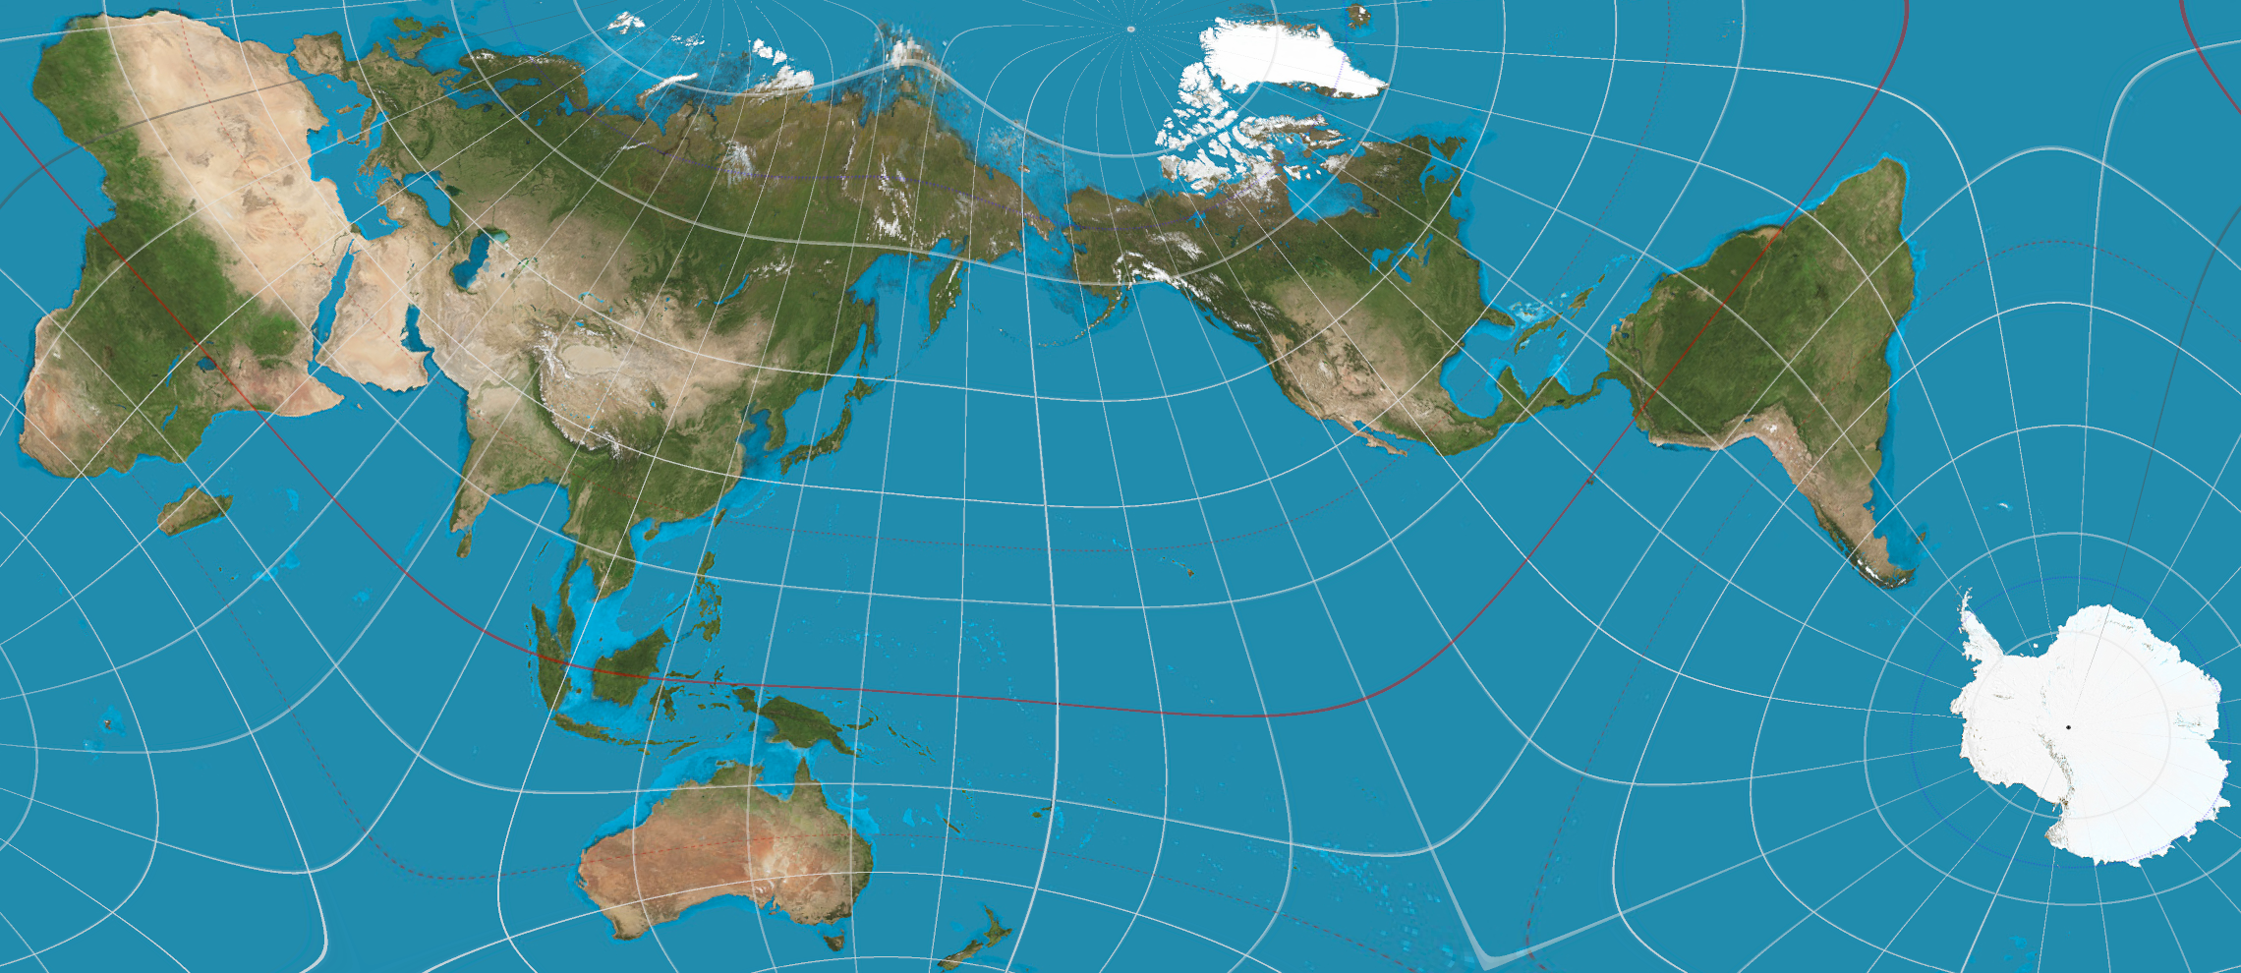
Creating and loading spatial data
Other types of projections
AuthaGraph: aims to accurately represent the spherical Earth on a flat rectangle by minimizing distortion of continents' sizes and shapes

Slide 25
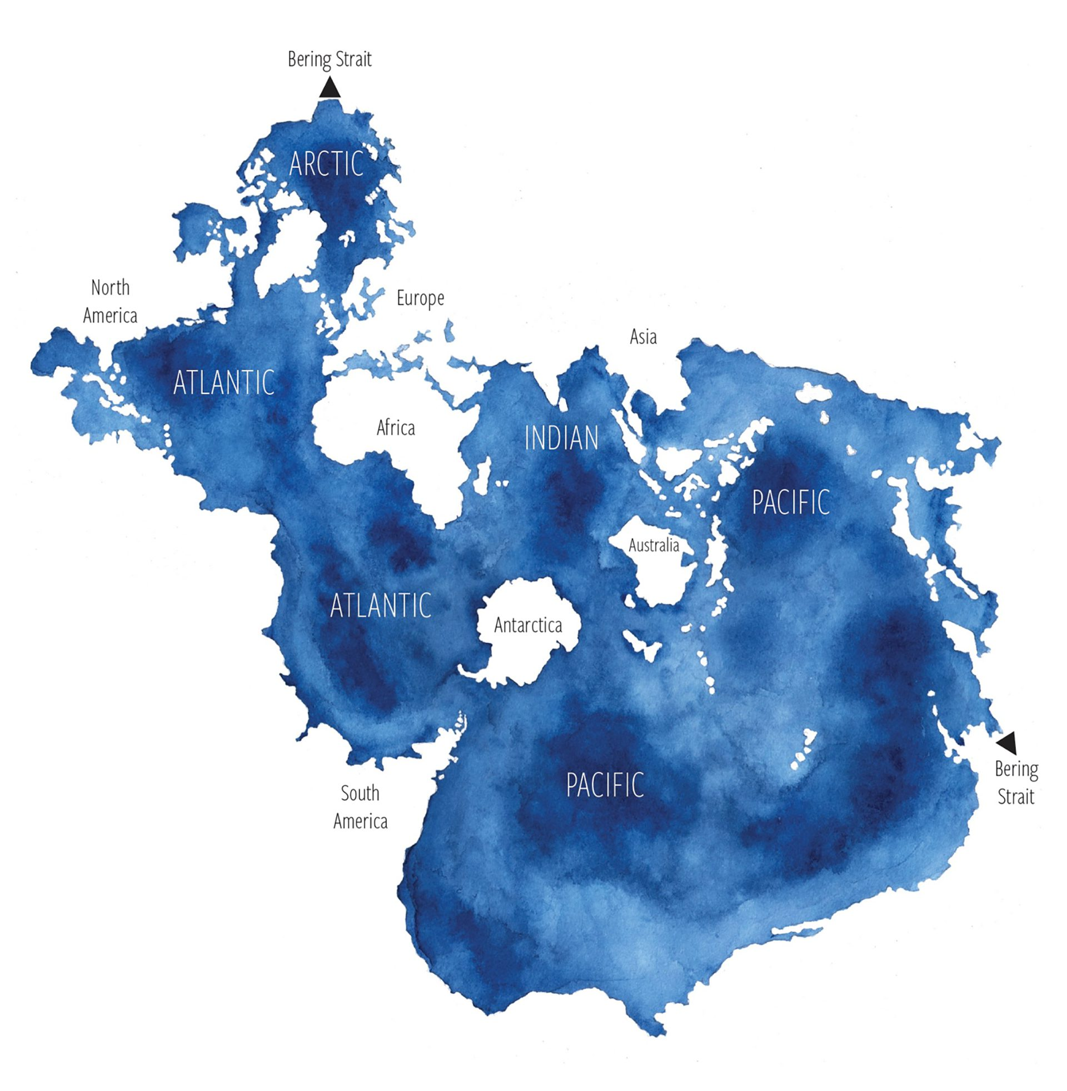
Creating and loading spatial data
Other types of projections
Spilhaus World Ocean Map Projection

Slide 26
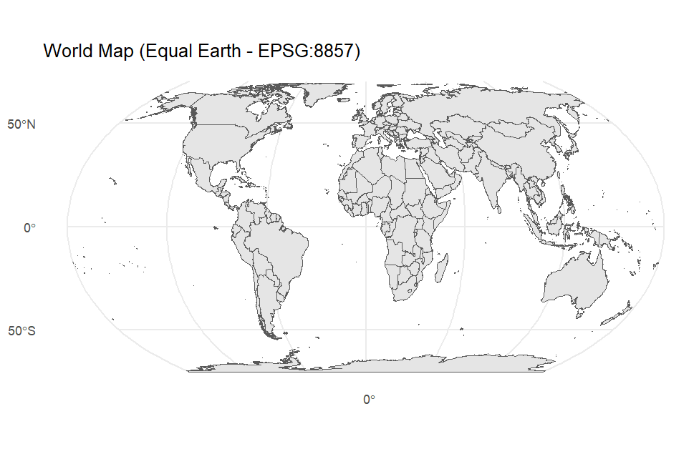
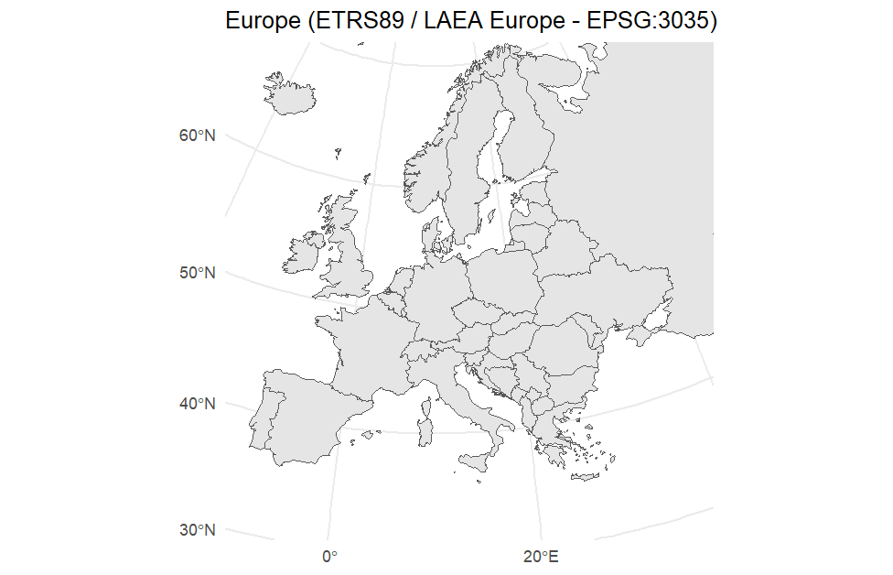
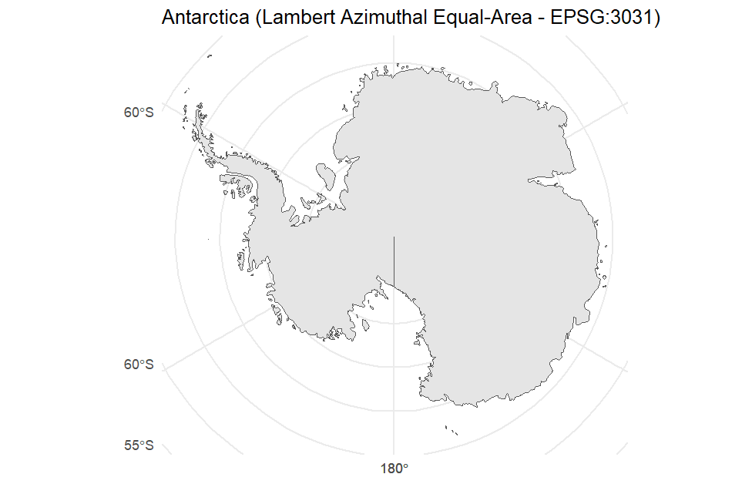
Creating and loading spatial data
For someone working in ecology or conservation, which projection type works best?
Equal-area (or equivalent) projection
Global map: Equal Earth, Mollweide, Gall-Peters, Goode's Homolosine
Mid-latitude: Albers Equal-Area Conic
Polar region: Lambert Azimuthal Equal-Area (centered on the pole)

Slide 27
Creating and loading spatial data
In R Studio…
ggplot(world) +
geom_sf() +
coord_sf(crs = st_crs(8857)) +
ggtitle("World Map (Equal Earth - EPSG:8857)") +
theme_minimal()

Slide 28
Creating and loading spatial data
EPSG stands for European Petroleum Survey Group
EPSG code is a unique identifier used to represent coordinate systems
EPSG:4326: The most widely used geographic coordinate system, used by GPS and standard global datasets
EPSG:3857: The Web Mercator projection used by Google Map and OpenStreetMap

Slide 29
Creating and loading spatial data
Extra
Convert .shp to .geojson
Convert .csv to .geojson

Slide 30
Session 2
21/01/2026

Slide 31
Publication-ready static maps in R
Load local spatial data (points, lines, polygons)
Combine them in a clean ggplot map
Add web layers (ArcGIS + Natural Earth)
Zoom to area of interest
Export a high-resolution figure
Extra: custom publication theme function

Slide 32
Lunch break
21/01/2026

Slide 33
Session 3
21/01/2026

Slide 34
Interactive maps and mixed data sources
Create basic leaflet map
Build a local map with points, lines, polygons
Add web data layers (ArcGIS + GeoJSON)
Create a fully functional interactive map
Extra: add raster layer

Slide 35
Session 4
21/01/2026

Slide 36
Publishing maps online
GitHub basics for publishing
Creating a simple R Markdown page
Embedding the interactive map
Publishing via GitHub Pages
Sharing the live URL
Extra: Quatro page

Slide 37
Publishing maps online
Create a new repository on GitHub
Add README file
Open with GitHub Desktop
Set a location path
File explorer
R Markdown file -> save to relevant folder

Slide 38
Publishing maps online
Markdown overview
YAML header
Title, author and so on
Body
Headings: #, ##, ###
Paragraph
Code chunks
echo = FALSE → hide code (show results only)
message = FALSE, warning = FALSE → suppress messages/warnings
Set up chunk
Output + rendering (“Knit”)

Slide 39
Publishing maps online
Markdown
Copy over set up
Copy over code
Add header, text
Code chunk
{r, echo=FALSE, message=FALSE, warning=FALSE}

Slide 40
Publishing maps online
GitHub
File explorer
index.html
GitHub Desktop –update
GitHub online
Repository
Pages
Deploy from main branch
Visit page

Slide 41
Publishing maps online
Extra: Quarto page
Single page
Theme
Tabs

Slide 42
Resources
https://r-spatial.github.io/sf/
https://docs.qgis.org/3.40/en/docs/gentle_gis_introduction/coordinate_reference_systems.html
https://www.esri.com/arcgis-blog/products/arcgis-pro/education/earth-peel
https://www.esri.com/arcgis-blog/products/arcgis-pro/mapping/mercator-its-not-hip-to-be-square
https://ggplot2.tidyverse.org/reference/ggtheme.html
https://rstudio.github.io/leaflet/articles/leaflet.html
https://rstudio.github.io/cheatsheets/html/rmarkdown.html
https://rstudio.github.io/cheatsheets/html/quarto.html
https://quarto.org/docs/output-formats/html-themes.html

